Slide 1
REVIEW OF TWO-PERIOD MODEL
CHAPTER 1
(Modern Macroeconomics - Sanjay K. Chugh)

Slide 2
UTILITY FUNCTIONS
Review of Consumer Theory
Describe how much “happiness” or “satisfaction” an individual experiences from “consuming” goods – the benefit of consumption
Marginal Utility
  The extra total utility resulting from consumption of a small/incremental extra unit of a good
  Mathematically, the (partial) slope of utility with respect to that good

Slide 3
UTILITY FUNCTIONS
Review of Consumer Theory
Alternative notation: du/dc OR u’(c) OR u_{c}(c) OR u₁(c)
One-good case: u(c), with du/dc > 0 and d²u/dc² < 0
  Recall interpretation: strictly increasing at a strictly decreasing rate
  Diminishing marginal utility

Slide 4
UTILITY FUNCTIONS
Review of Consumer Theory
Two-good case: u(c₁, c₂), with u_{i}(c₁, c₂) > 0 and u_{ii}(c₁, c₂) < 0 for each of i = 1,2
  Utility strictly increasing in each good individually (partial)
  Diminishing marginal utility in each good individually
  Easily extends to N-good case: u(c₁, c₂, c₃, c₄,…, c_{N})

Slide 5
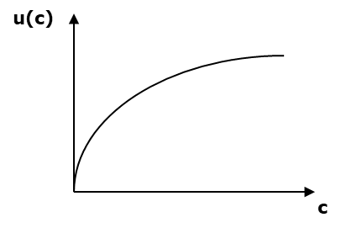
UTILITY FUNCTIONS
Review of Consumer Theory
One-good case
Slope (marginal utility) asymptotes to (but never reaches…) zero
Example: u(c) = ln c or u(c) = sqrt(c)

Slide 6
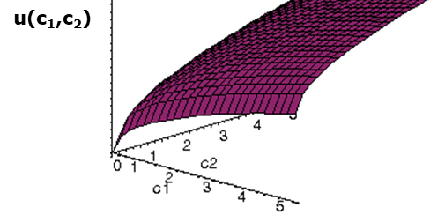
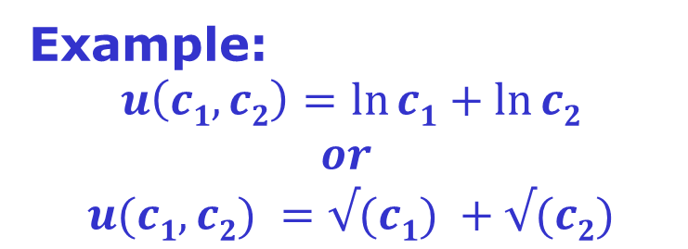
UTILITY FUNCTIONS
Review of Consumer Theory
Two-good case
Example:
$$u\left(c1, c2\right)=\ln{c1}+\ln{c2}$$
$$or$$
$$u(c1, c2) =√(c1) +√(c2)$$

Slide 7
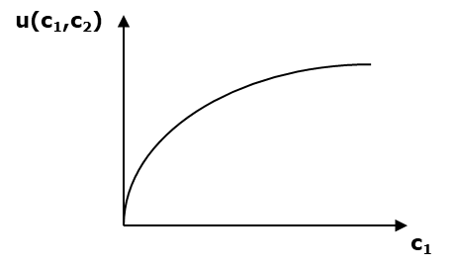
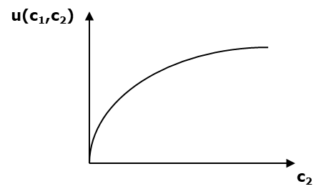
UTILITY FUNCTIONS
Review of Consumer Theory
Viewed in good-by-good space

Slide 8
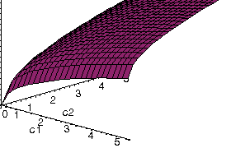
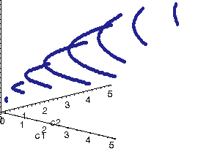
UTILITY FUNCTIONS
Review of Consumer Theory
Alternative views
Indifference Curve: the set of all consumption bundles that deliver a particular level of utility/happiness
Emphasizing the contours

Slide 9
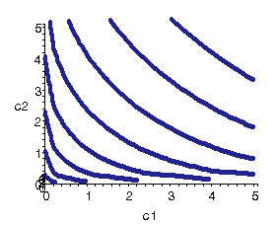
UTILITY FUNCTIONS
Review of Consumer Theory
Alternative views
Top-down view of contour

Slide 10
UTILITY FUNCTIONS
Review of Consumer Theory
Marginal Rate of Substitution (MRS)
  Maximum quantity of one good consumer is willing to give up to obtain one extra unit of the other good
  Graphically, the (negative of the) slope of
  an indifference curve
  MRS is itself a function of c₁ and c₂
  (i.e., MRS(c₁, c₂))

Slide 11



UTILITY FUNCTIONS
Review of Consumer Theory
c₂
$$\overline{c_{2}}$$
$$\overline{c_{1}}$$
c₁
$$∆$$

Slide 12
UTILITY FUNCTIONS
Review of Consumer Theory
  MRS equals ratio of marginal utilities
    Using Implicit Function Theorem

Slide 13
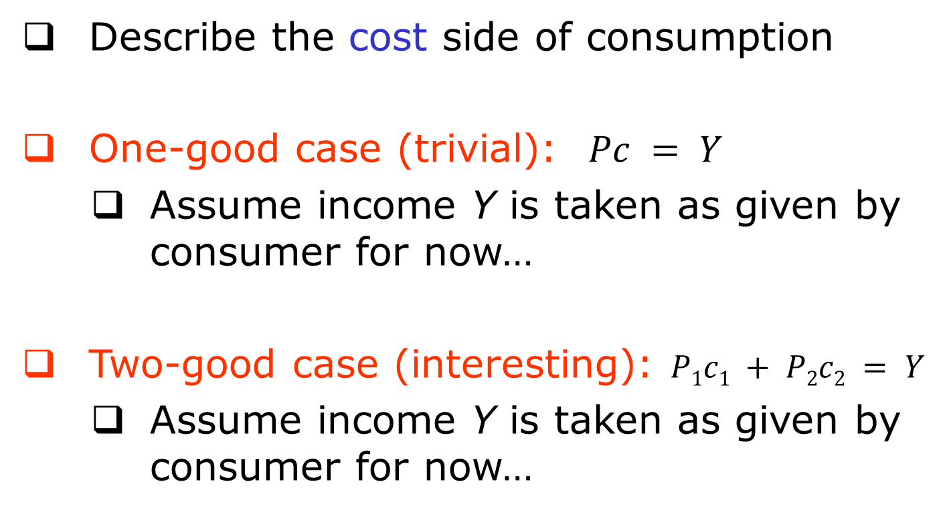
BUDGET CONSTRAINTS
The Graphics of Consumer Theory
Describe the cost side of consumption
One-good case (trivial): $Pc = Y$
  Assume income Y is taken as given by consumer for now…
Two-good case (interesting): $P1c1 + P2c2 = Y$
  Assume income Y is taken as given by consumer for now…

Slide 14
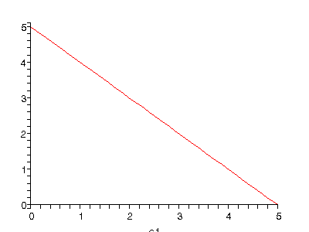
BUDGET CONSTRAINTS
The Graphics of Consumer Theory
Isolate c₂ to graph the budget constraint
Plotted in 2D-consumption-space
c₂
Slope = -P₁/P₂
c₁

Slide 15
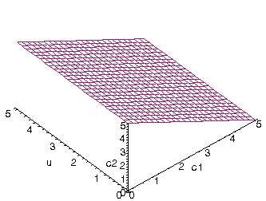
BUDGET CONSTRAINTS
The Graphics of Consumer Theory
Plotted in 3D-consumption-space
Plotted in 2D-consumption-space
c₂
Slope = -P₁/P₂
c₁

Slide 16
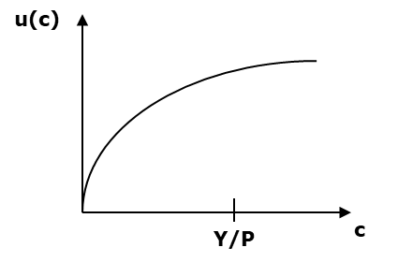
CONSUMER OPTIMIZATION
The Graphics of Consumer Theory
Consumer’s decision problem: maximize utility subject to budget constraint – bring together both cost side and benefit side
One-good case
  Trivially, choose c = Y/P
  No decision to make here…

Slide 17
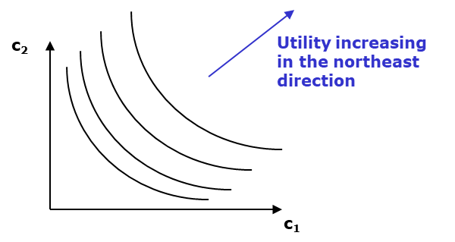
CONSUMER OPTIMIZATION
The Graphics of Consumer Theory
Two-good case
  How to optimally allocate Y across the two goods c₁ and c₂?
  A non-trivial decision problem…

Slide 18
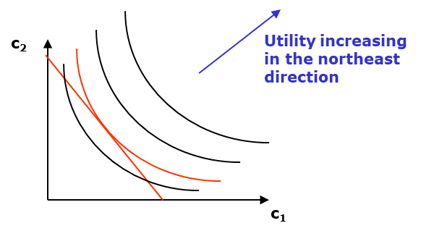
CONSUMER OPTIMIZATION
The Graphics of Consumer Theory
Two-good case
  How to optimally allocate Y across the two goods c₁ and c₂?
  A non-trivial decision problem…

Slide 19
CONSUMER OPTIMIZATION
The Graphics of Consumer Theory
Two-good case
  How to optimally allocate Y across the two goods c₁ and c₂?
  A non-trivial decision problem…
Optimal choice occurs at point of tangency
Highest attainable indifference curve

Slide 20
CONSUMER OPTIMIZATION
The Graphics of Consumer Theory
OPTIMALITY CONDITION:
At the optimal choice,
MRS = slope of budget line
ratio of marginal utilities
price ratio
=

Slide 21
LAGRANGE METHOD
The Mathematics of Consumer Theory
Consumer optimization a constrained optimization problem
  Maximize some function (economic application: utility function)…
  …taking into account some restriction on the objects to be maximized over (economic application: budget constraint)
Lagrange Method: mathematical tool to solve constrained optimization problems

Slide 22
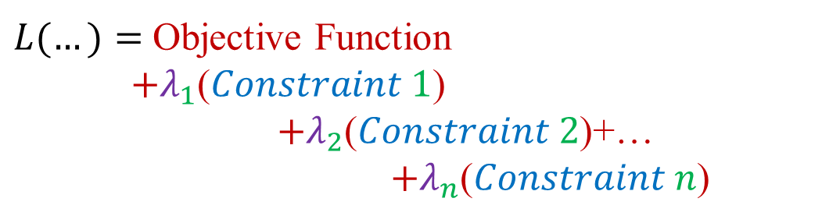
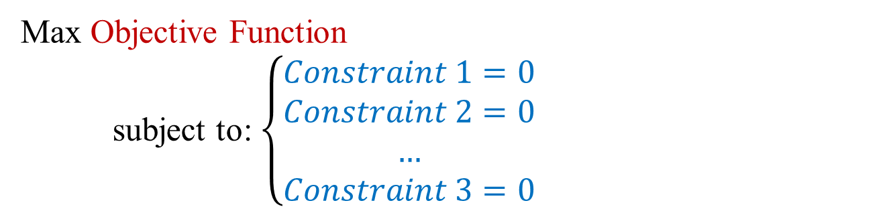
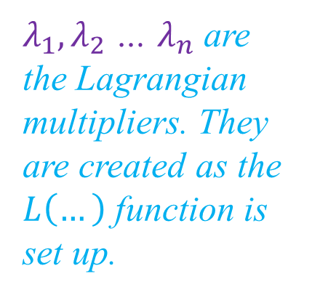
Maximizing an OBJECTIVE conditioned on some CONSTRAINTS
Original setting
Max Objective Function
subject to: $\left\{\begin{aligned}Constraint 1=0 \\ Constraint 2=0 \\ … \\ Constraint 3=0\end{aligned}\right.$
Set up another function
$λ_{1},λ_{2}$ … $λ_{n}$ are the Lagrangian multipliers. They are created as the $L\left(…\right)$ function is set up.
$L(…)=$ Objective Function
$+λ_{1}$($Constraint 1$)
$+λ_{2}$($Constraint 2$)+…
$+λ_{n}$($Constraint n$)

Slide 23
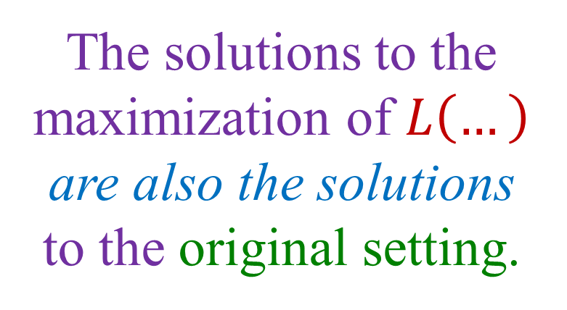
Lagrange (the mathematician) proved a very useful result:
The solutions to the maximization of $L\left(…\right)$ are also the solutions to the original setting.

Slide 24
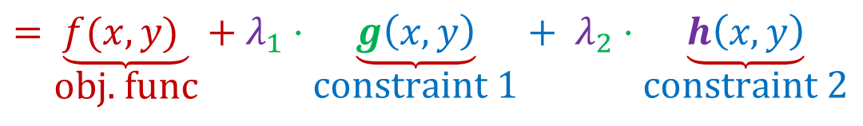
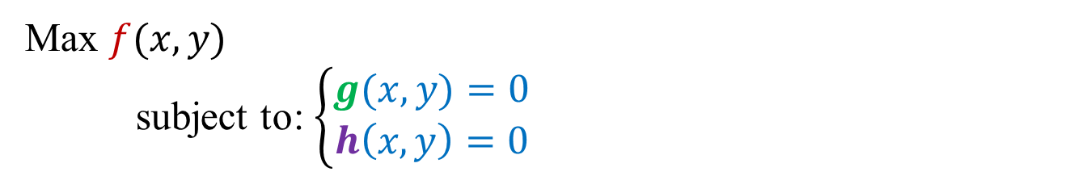
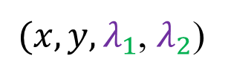

Example:
Max $f(x,y)$
subject to: $\left\{\begin{aligned}g(x,y)=0 \\ h\left(x,y\right)=0\end{aligned}\right.$
Set up the Lagrangian function for this problem, we have:
$$L$$
$(x,y,λ_{1}$, $λ_{2}$)
$$=\underset{\text{obj}\text{. }\text{func}}{\underbrace{f(x,y) }}+λ_{1}⋅\underset{\text{constraint}\text{ 1}}{\underbrace{g\left(x,y\right)}}+ λ_{2}⋅\underset{\text{constraint}\text{ 2}}{\underbrace{h\left(x,y\right)}}$$
Function with 4 variables

Slide 25
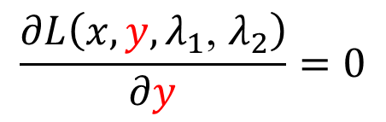

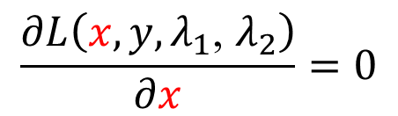
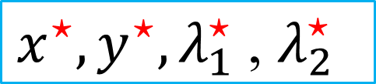
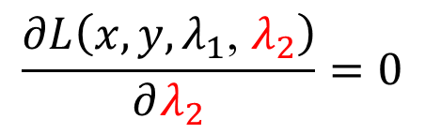
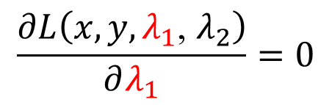
We do the usual FOCs:
$$\frac{∂L\left(x,y,λ_{1}\text{, }λ_{2}\right)}{∂x}=0$$
$$\frac{∂L\left(x,y,λ_{1}\text{, }λ_{2}\right)}{∂y}=0$$
$x^{⋆},y^{⋆},λ_{1}^{⋆} \text{, }λ_{2}^{⋆}$
$$\frac{∂L\left(x,y,λ_{1}\text{, }λ_{2}\right)}{∂λ_{1}}=0$$
$$\frac{∂L\left(x,y,λ_{1}\text{, }λ_{2}\right)}{∂λ_{2}}=0$$
$Solution to$
Max $L\left(x,y,λ_{1}\text{, }λ_{2}\right)$

Slide 26
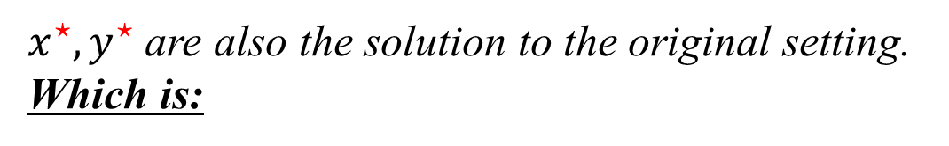

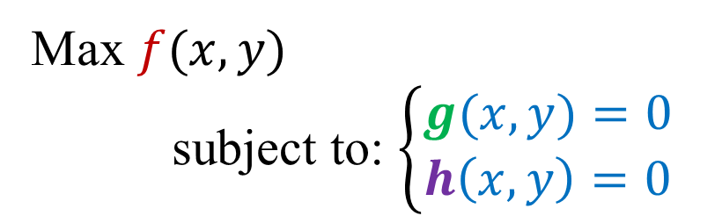
$x^{⋆},y^{⋆},λ_{1}^{⋆} \text{, }λ_{2}^{⋆}$
$x^{⋆},y^{⋆}$ are also the solution to the original setting. Which is:
Max $f(x,y)$
subject to: $\left\{\begin{aligned}g(x,y)=0 \\ h\left(x,y\right)=0\end{aligned}\right.$

Slide 27
LAGRANGE METHOD
The Mathematics of Consumer Theory
General mathematical formulation
  Choose (x, y) to maximize a given objective function f(x,y)…
  …subject to the constraint g(x,y) = 0 (Note formulation of constraint)
  Step 1: Construct Lagrange function
Lagrange multiplier

Slide 28
LAGRANGE ANALYSIS
The Mathematics of Consumer Theory
  Step 2: Compute first-order conditions with respect to x, y, and λ
Lagrange multiplier
Rationale: setting first derivatives to zero isolates maxima (or minima…technically, need to check second-order condition…)
1)
2)
3)

Slide 29
LAGRANGE ANALYSIS
The Mathematics of Consumer Theory
Step 3: Solve the system of first-order conditions for x, y, and λ
  Often most interested in simply eliminating the multiplier…
  From eqn 1), isolate λ:
  Insert expression for λ in eqn 2):

Slide 30
LAGRANGE ANALYSIS
The Mathematics of Consumer Theory
Step 3:
  ……
  Rearrange
  Optimality condition: at the optimum (x*, y*)

Slide 31
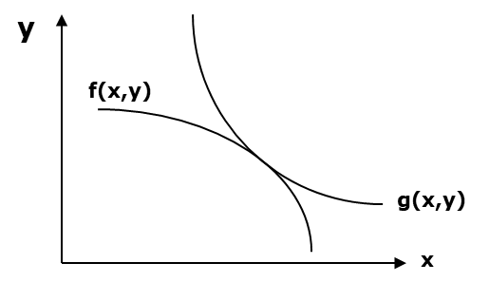
LAGRANGE ANALYSIS
The Mathematics of Consumer Theory
Step 3:
  …
Graphical interpretation: at the constrained optimum, the function f(.) is tangent to the function g(.)
g (x,y)
The constrained optimum (x*, y*)
f (x,y)

Slide 32
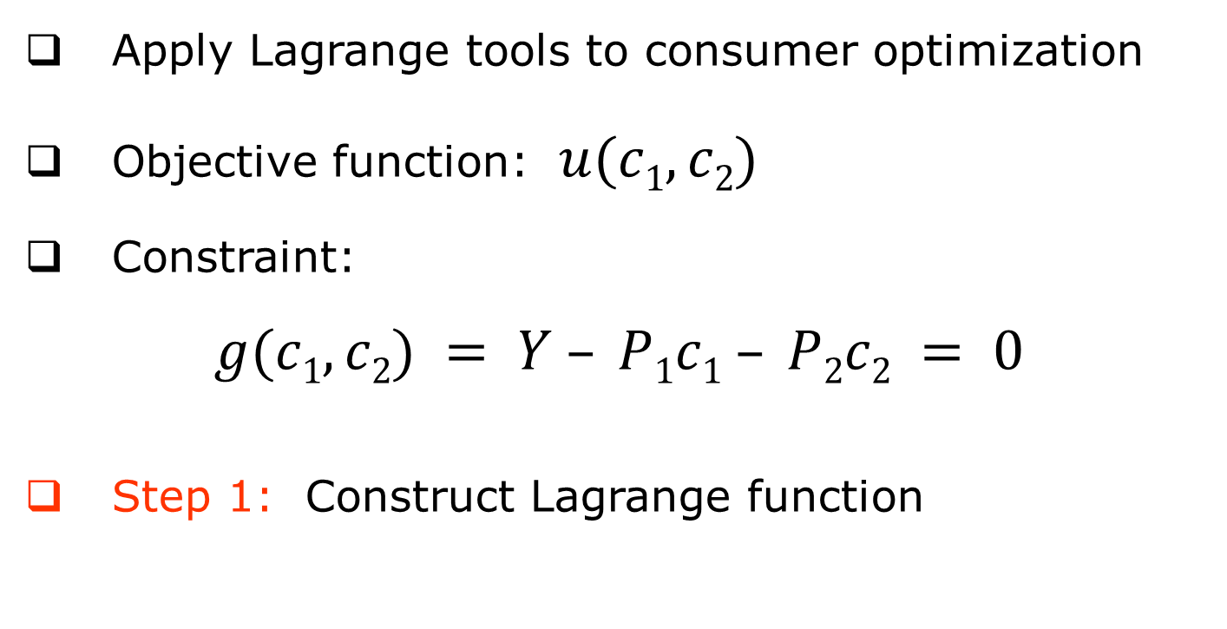
LAGRANGE ANALYSIS
The Mathematics of Consumer Theory
Apply Lagrange tools to consumer optimization
Objective function: $u(c1,c2)$
Constraint:
$$g(c1,c2) = Y – P1c1 – P2c2 = 0$$
Step 1: Construct Lagrange function

Slide 33
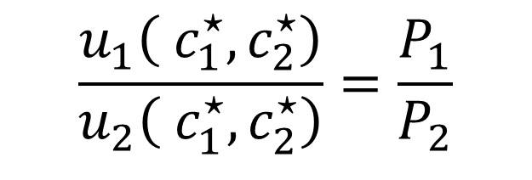
LAGRANGE ANALYSIS
The Mathematics of Consumer Theory
Step 2: Compute first-order conditions with respect to c₁, c₂, λ
Step 3: Solve (focus on eliminating multiplier from eqns 1 & 2)
1)
2)
3)
$$\frac{u_{1}\left( c_{1}^{⋆},c_{2}^{⋆}\right)}{u_{2}\left( c_{1}^{⋆},c_{2}^{⋆}\right)}=\frac{P_{1}}{P_{2}}$$
OPTIMALITY CONDITION
i.e., MRS = price ratio

Slide 34


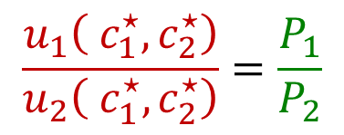
$$\frac{u_{1}\left( c_{1}^{⋆},c_{2}^{⋆}\right)}{u_{2}\left( c_{1}^{⋆},c_{2}^{⋆}\right)}=\frac{P_{1}}{P_{2}}$$
$$c_{2}$$
$$c_{1}$$

Slide 35
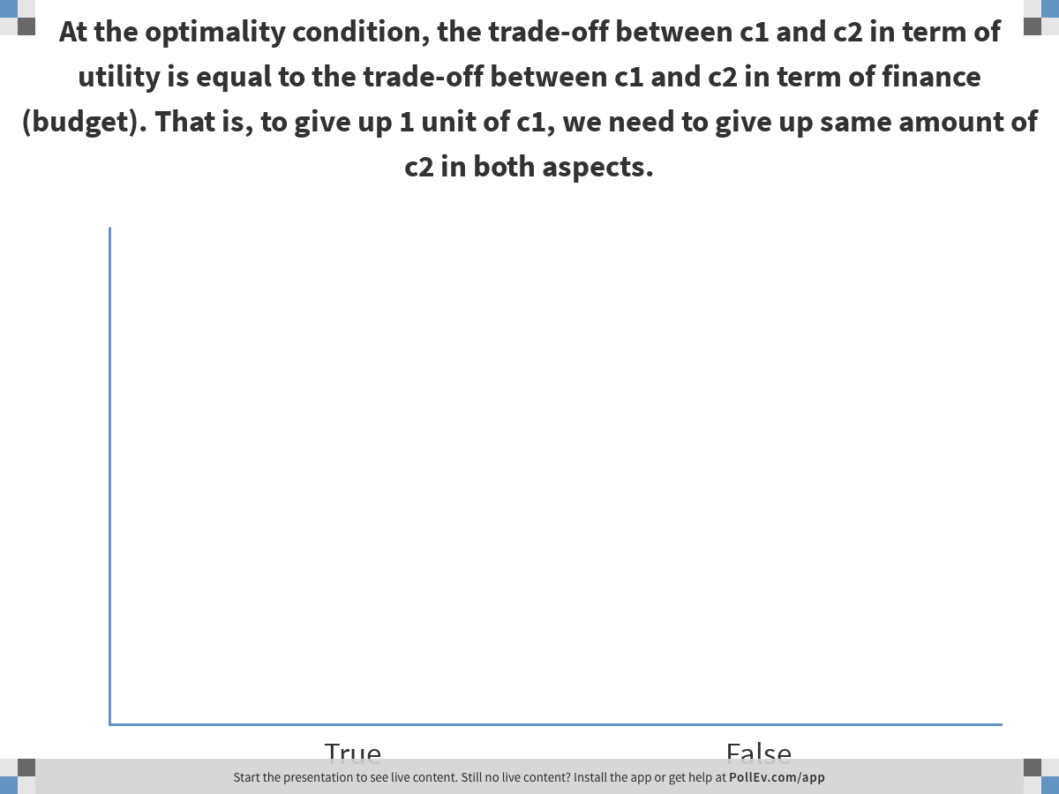
Notes:
Poll Title: At the optimality condition, the trade-off between c1 and c2 in term of utility is equal to the trade-off between c1 and c2 in term of finance (budget). That is, to give up 1 unit of c1, we need to give up same amount of c2 in both aspects.
https://www.polleverywhere.com/multiple_choice_polls/WBvJU9GUj4gPCcoqMIRew?flow=Default&onscreen=persist

Slide 36
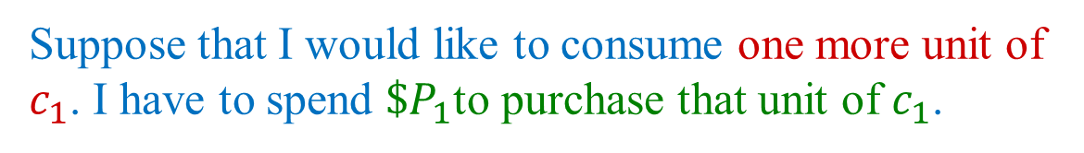
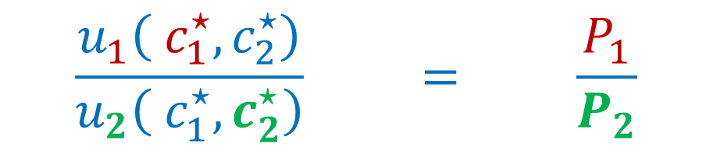
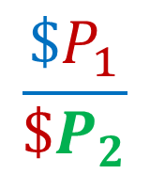
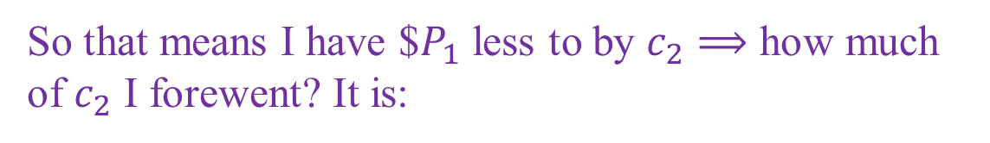
$$\frac{u_{1}\left( c_{1}^{⋆},c_{2}^{⋆}\right)}{u_{2}\left( c_{1}^{⋆},c_{2}^{⋆}\right)} = \frac{P_{1}}{P_{2}}$$
MRS: tradeoff in term of utility
Price ratio: trade-off in term of money
Suppose that I would like to consume one more unit of $c_{1}$. I have to spend ${\$P}_{1}$to purchase that unit of $c_{1}$.
So that means I have $$P_{1}$ less to by $c_{2}⟹$ how much of $c_{2}$ I forewent? It is:
$$\frac{\$P_{1}}{\$P_{2}}$$

Slide 37
CONSUMPTION-SAVINGS FRAMEWORK
CHAPTER 3
(Modern Macroeconomics - Sanjay K. Chugh)

Slide 38


THE MACROECONOMICS OF TIME
Introduction
Dynamic frameworks the core of modern macroeconomic analysis
Explicit consideration of how economic decisions/behaviors/outcomes unfold over multiple time periods
$$Period 1$$
$$Period 2$$
Simplest dynamic model:
Eg. Savings/Investments across time

Slide 39
THE MACROECONOMICS OF TIME
Introduction
Two-period framework (Chapters 3 and 4) the simplest possible multi-period framework
  Will allow us to begin analyzing issues regarding interest rates and inflation (phenomena that occur across time)
  Will allow us to think about credit restrictions and the “credit crunch”
Infinite-period framework (Chapter 8)
  Allows a richer quantitative description of the macroeconomy
  Highlights the role of assets and the intersection between finance and macroeconomics

Slide 40
BASICS
Introduction
Timeline of events
Intra-temporal decisions
Intra-temporal decisions
Inter-temporal
decision
Start of economic planning horizon
End of economic planning horizon

Slide 41
BASICS
Introduction
Notation
  c₁: consumption in period 1
  c₂: consumption in period 2
  P₁: nominal price of consumption in period 1
  P₂: nominal price of consumption in period 2
  Y₁: nominal income in period 1 (“falls from the sky”)
  Y₂: nominal income in period 2 (“falls from the sky”)
  ...

Slide 42
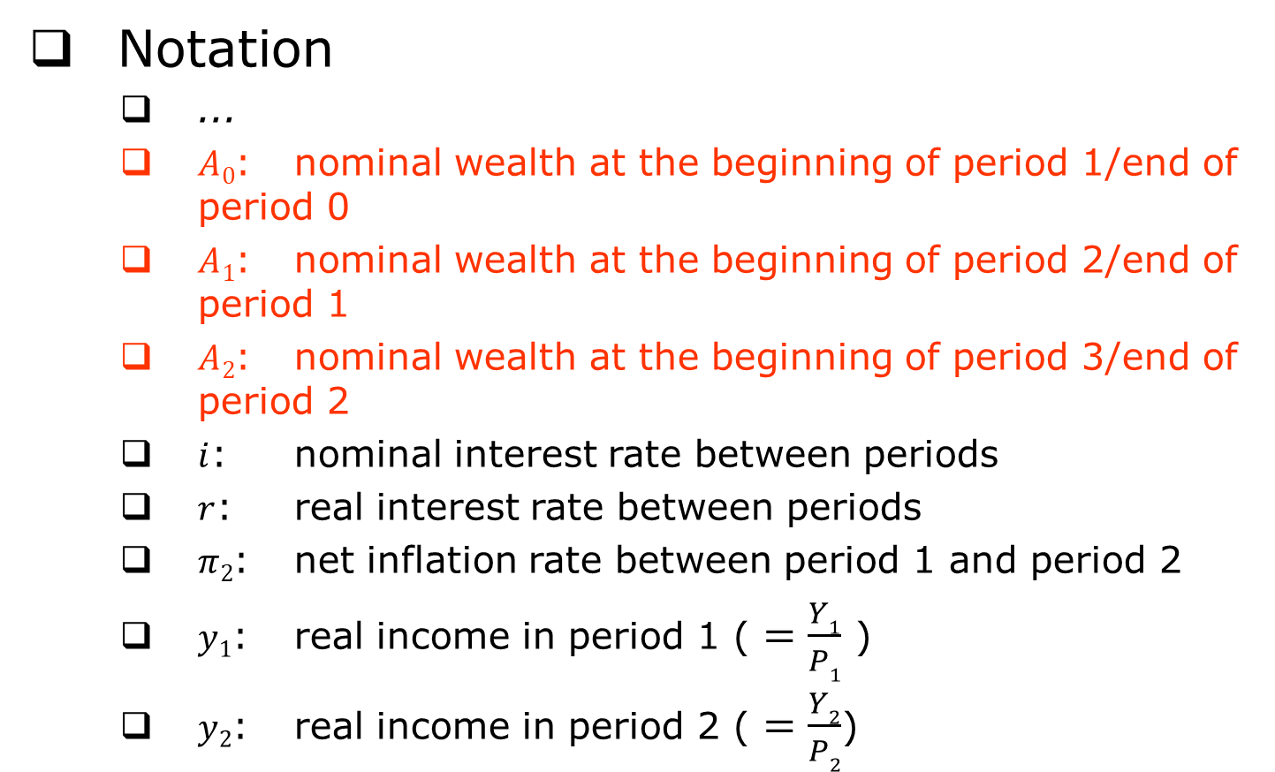
BASICS
Introduction
Notation
  ...
  $A0$: nominal wealth at the beginning of period 1/end of period 0
  $A1$: nominal wealth at the beginning of period 2/end of period 1
  $A2$: nominal wealth at the beginning of period 3/end of period 2
  $i$: nominal interest rate between periods
  $r$: real interest rate between periods
  $π2$: net inflation rate between period 1 and period 2
  $y1$: real income in period 1 ( $=\frac{Y1}{P1}$ )
  $y2$: real income in period 2 ( $=\frac{Y2}{P2}$)

Slide 43

STOCKS VS. FLOWS
Macro Fundamentals
Stock variables, aka accumulation variables
  Quantity variables whose natural measurement occurs at a particular moment in time
  Checking account balance
  Credit card indebtedness
  Mortgage loan payoff
A is a stock variable
A country’s debt?
$$t$$

Slide 44
STOCKS VS. FLOWS
Macro Fundamentals
Flow variables
  Quantity variables whose natural measurement occurs over the course of a given interval of time
  Income
  Consumption
  Savings
The two broad categories of income
  Labor income
  Asset income (generated by interest rate(s) on (components of) wealth)

Slide 45
BASICS
Macro Fundamentals
Building blocks of consumption-savings framework
Utility
  Describes the benefits of engaging in financial market (and other) activities
Budget constraint
  Describes the costs of engaging in financial market (and other) activities
Same building blocks

Slide 46
UTILITY
Model Structure
Preferences u(c₁, c₂) with all the “usual properties”
  Lifetime utility function
  Strictly increasing in c₁
  Strictly increasing in c₂
  Diminishing marginal utility in c₁
  Diminishing marginal utility in c₂

Slide 47
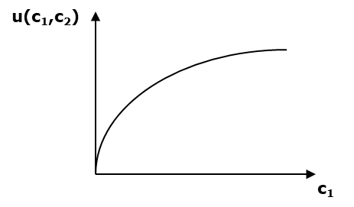
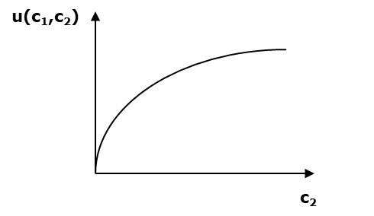
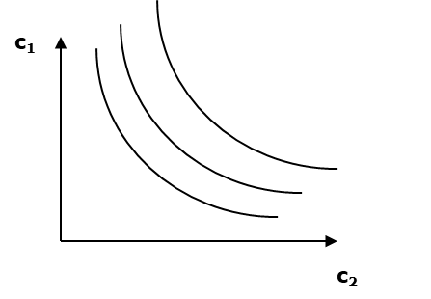
UTILITY
Model Structure
  Plotted as indifference curves
  Utility side of consumption-savings
  framework identical to Chapter 1
  framework

Slide 48
BUDGET CONSTRAINT(S)
Model Structure
Suppose again Y “falls from the sky”
  Y₁ in period 1, Y₂ in period 2
Need two budget constraints to describe economic opportunities and possibilities
  One for each period

Slide 49
BUDGET CONSTRAINT(S)
Model Structure
Asset income during period 1 (a flow)
  Period-1 budget constraint
Savings during period 1 (a flow)
Total expenditure in period 1: period-1 consumption + wealth to carry into period 2
Total income in period 1: period-1 Y + income from wealth carried into period 1 (inclusive of interest)

Slide 50
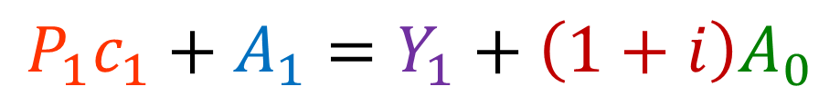
Rate of return on asset
Initial wealth (e.g. inheritance)
Endowment
$$P_{1}c_{1}+A_{1}=Y_{1}+\left(1+i\right)A_{0}$$
Consume
+
take out of period 1
Have in period 1
Consumption 1
Assets brought to period 2

Slide 51

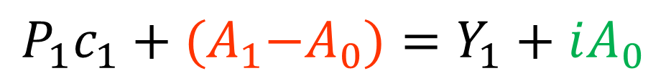

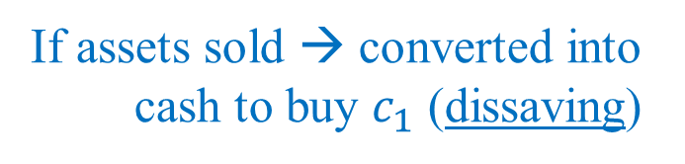
$$A_{0}+\left(A_{1}−A_{0}\right)=A_{1}$$
Top-up
or sell
Interest rate earned from $A_{0}$
$$P_{1}c_{1}+{(A}_{1}−A_{0})=Y_{1}+iA_{0}$$
If new assets purchased: Purchased by savings
Amount of new assets bought (or sold)
If assets sold → converted into cash to buy $c_{1}$ (dissaving)

Slide 52
BUDGET CONSTRAINT(S)
Model Structure
  Period-2 budget constraint
Asset income during period 2 (a flow)
Savings during period 2 (a flow)
Total expenditure in period 2: period-2 consumption + wealth to carry into period 3
Total income in period 2: period-2 Y + income from wealth carried into period 2 (inclusive of interest)

Slide 53
BUDGET CONSTRAINT(S)
Model Structure
Adopt a lifetime view of the budget constraint(s)
  All analysis conducted from perspective of beginning of period 1
  Period-1 budget constraint
  Period-2 budget constraint
Asset position at end of period 1/beginning of period 2 the key link
- will think further about this soon…
Assume = 0 (no bankruptcies + strictly increasing utility)

Slide 54
BUDGET CONSTRAINT(S)
Model Structure
  Combine into lifetime budget constraint (LBC)
    Solve period-2 budget constraint for A₁…
    …and substitute into period-1 budget constraint
No more asset holding in between
Present discounted value (PDV) of all lifetime expenditure
Present discounted value (PDV) of all lifetime income
For graphical simplicity, will often assume A₀ = 0 (i.e., consumer begins planning horizon with zero net wealth).
Note this is a different assumption than A₂ = 0.
Notes:
Do you think writing the equation this way is useful for the study of saving behavior? (PollEV)

Slide 55
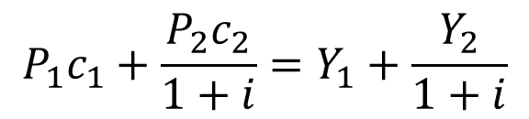
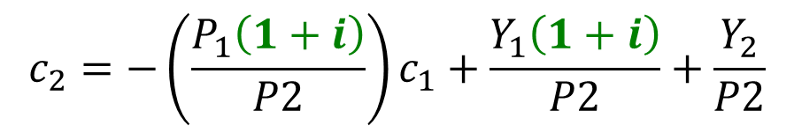
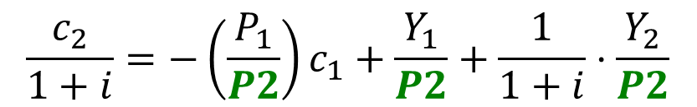
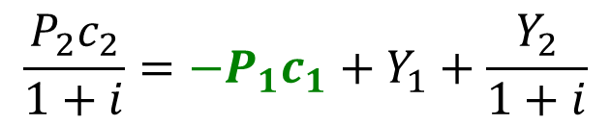
LIFETIME BUDGET CONSTRAINT
Model Structure
$$P_{1}c_{1}+\frac{P_{2}c_{2}}{1+i}=Y_{1}+\frac{Y_{2}}{1+i}$$
subtract P₁c₁
$$\frac{P_{2}c_{2}}{1+i}={−P}_{1}c_{1}+Y_{1}+\frac{Y_{2}}{1+i}$$
divide by P₂
$$\frac{c_{2}}{1+i}=−\left(\frac{P_{1}}{P2}\right)c_{1}+\frac{Y_{1}}{P2}+\frac{1}{1+i}⋅\frac{Y_{2}}{P2}$$
multiply by (1+i)
$$c_{2}=−\left(\frac{P_{1}\left(1+i\right)}{P2}\right)c_{1}+\frac{Y_{1}\left(1+i\right)}{P2}+\frac{Y_{2}}{P2}$$

Slide 56
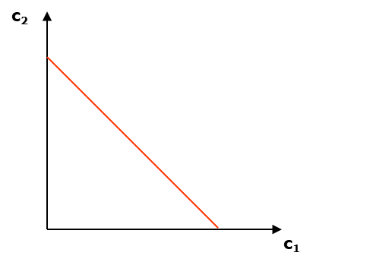

$$slope = −\frac{P_{1}\left(1+i\right)}{P_{2}}$$

Slide 57

LIFETIME BUDGET CONSTRAINT
Model Structure
Rearrange further using definition of inflation:
$$slope = −(1+i)/(1+π2)$$
IMPORTANT: Changes in nominal interest rates (Fed) and/or inflation affect the slope of the LBC

Slide 58

CONSUMER OPTIMIZATION
Model Structure
Consumer’s decision problem: maximize lifetime utility subject to lifetime budget constraint – bring together both cost side and benefit side
  Choose c₁ and c₂ subject to
  Plot budget line
$$slope = −(1+i)/(1+π2)$$

Slide 59
CONSUMER OPTIMIZATION
Model Structure
  Superimpose indifference map
optimal choice

Slide 60
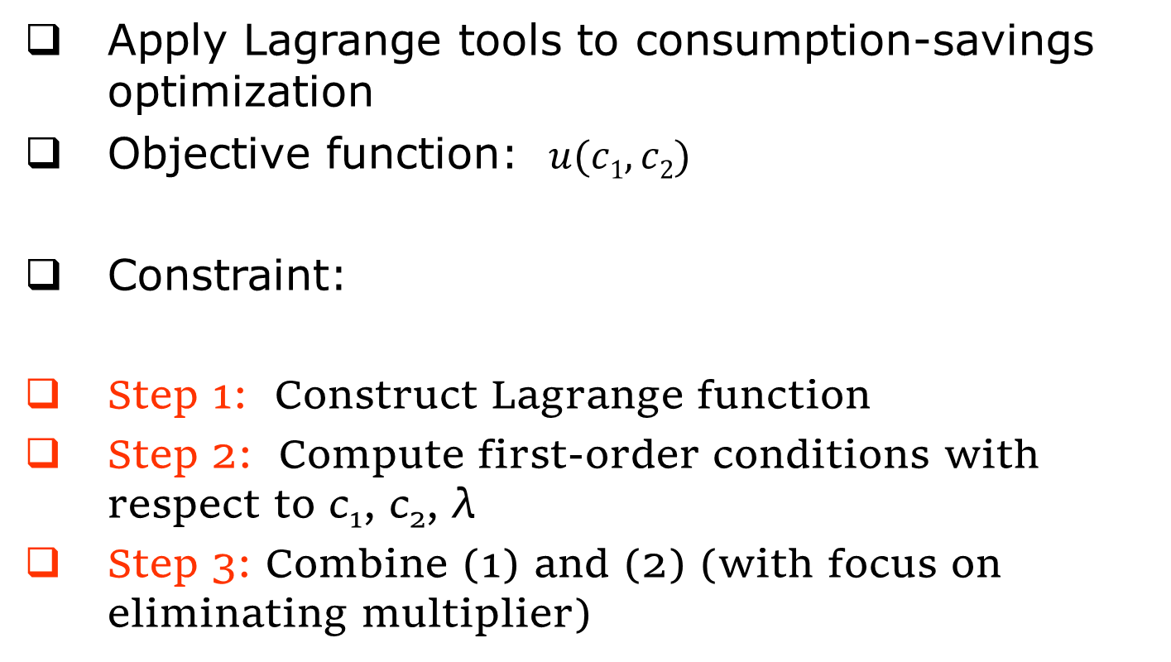
LAGRANGE ANALYSIS
The Mathematics of the Consumption-Savings Model
Apply Lagrange tools to consumption-savings optimization
Objective function: $u(c1,c2)$
Constraint:
Step 1: Construct Lagrange function
Step 2: Compute first-order conditions with respect to c₁, c₂, λ
Step 3: Combine (1) and (2) (with focus on eliminating multiplier)

Slide 61




LAGRANGE ANALYSIS
The Mathematics of the Consumption-Savings Model
Step 1: Construct Lagrange function
Step 2: Compute first-order conditions with respect to c₁, c₂, λ
(1)
$∂L(…)/∂c_{1}$ =$0$
(2)
$∂L(…)/∂c_{2}$ =$0$
$$Y_{1}+\frac{Y_{2}}{1+i}−P_{1}c_{1}−\frac{P_{2}c_{2}}{1+i}=0$$
(3)
$∂L(…)/∂λ$ =$0$

Slide 62









From 1:
$$u_{1}\left(c_{1},c_{2}\right)−λP_{1}=0$$
$${⟹λP_{1}=u}_{1}\left(c_{1},c_{2}\right)$$
$$⟹λ=\frac{u_{1}\left(c_{1},c_{2}\right)}{P_{1}}$$
$$u_{2}\left(c_{1},c_{2}\right)−\frac{λP_{2}}{1+i}=0$$
$$⟹u_{2}\left(c_{1},c_{2}\right)=\frac{λP_{2}}{1+i}$$
From 2:
$$⟹u_{2}\left(c_{1},c_{2}\right)=\frac{u_{1}\left(c_{1},c_{2}\right)}{P_{1}}\frac{P_{2}}{1+i}$$
$$⟹\frac{u_{2}\left(c_{1},c_{2}\right)}{u_{1}\left(c_{1},c_{2}\right)}=\frac{P_{2}}{P_{1}}\frac{1}{1+i}$$
$$⟹\frac{u_{2}\left(c_{1},c_{2}\right)}{u_{1}\left(c_{1},c_{2}\right)}=\frac{1+π_{2}}{1+i}$$
$$or \frac{u_{1}\left(c_{1},c_{2}\right)}{u_{2}\left(c_{1},c_{2}\right)}=\frac{1+i}{1+π_{2}}$$

Slide 63

LAGRANGE ANALYSIS
The Mathematics of the Consumption-Savings Model
Step 3: Combine (1) and (2) (with focus on eliminating multiplier)
CONSUMPTION-SAVINGS OPTIMALITY CONDITION
MRS (between consumption in consecutive time periods)
price ratio (across consecutive time periods)
$\frac{1+i}{1+π_{2}}$ determines where we should consume and thus savings

Slide 64





$$slope = −(1+i)/(1+π2)$$
$$c_{2}$$
Saver
$${\overline{c}}_{2}$$
$$y_{2}$$
$${\overline{c}}_{1}$$
$$y_{1}$$
$$c_{1}$$

Slide 65

Macro Fundamentals
(continuing to assume A₀ = 0)
c₂
optimal choice
“Dissaver”
Y₂/P₂
Y₁/P₁
c₁

Slide 66
INFLATION AND INTEREST RATES
IN THE CONSUMPTION-SAVINGS FRAMEWORK
CHAPTER 4
(Modern Macroeconomics - Sanjay K. Chugh)

Slide 67
FISHER EQUATION
Macro Fundamentals
Nominal interest rate – measured in dollars
Real interest rate – measured in goods
Fisher equation: a link between the nominal interest rate, inflation rate, and real interest rate
  “Strips out the effect of inflation”
  Exact Fisher equation

Slide 68

FISHER EQUATION
Macro Fundamentals
  Approximate Fisher equation (intro macro)
≈ 0
In advanced economies, $r$and$π$are both generally small → $rπ ≈ 0$
A useful rule of thumb

Slide 69


REAL INTEREST RATE
Macro Fundamentals
r a key variable for macroeconomic analysis
Unit Analysis (i.e., analyze algebraic units of variables)
Slope measures how much c₂ must be given up in order to obtain one more unit of c₁ (“rise over run”) when saving or dissaving at market interest rates
slope = $− (1+i)/(1+π2$)
= - (1+r)
BY FISHER EQUATION
1+r is the price of period-1 consumption in terms of period-2 consumption
More generally: 1+r measures the price of current goods in terms of future goods
Notes:
But if you wish to study the nominal (inflation, norminal interest rate, you need to keep them. But you can see that it is quite clean right?

Slide 70
REAL INTEREST RATE
Macro Fundamentals
Economic decisions depend on real interest rates (r), not nominal interest rates (i)
  Measures the cost of borrowing/lending in terms of goods…
  …which is presumably what people most care about

Slide 71


TWO-PERIOD FRAMEWORK IN REAL TERMS
From Nominal to Real
Depending on application, may be useful to work with framework (independent of lifetime vs. sequential approach) in nominal terms or in real terms
LBC in nominal terms (assuming A₀ = 0)
$$P_{1}c_{1}+\frac{P_{2}c_{2}}{1+i}=Y_{1}+\frac{Y_{2}}{1+i}$$
Divide by P₁
$$c_{1}+\left(\frac{P_{2}}{P_{1}\left(1+i\right)}\right)c_{2}=\frac{Y_{1}}{P_{1}}+\frac{Y_{2}}{P_{1}\left(1+i\right)}$$

Slide 72



TWO-PERIOD FRAMEWORK IN REAL TERMS
From Nominal to Real
$$c_{1}+\left(\frac{P_{2}}{P_{1}\left(1+i\right)}\right)c_{2}=\frac{Y_{1}}{P_{1}}+\frac{Y_{2}}{P_{1}\left(1+i\right)}$$
LBC in real terms (assuming A₀ = 0)
Multiply and divide last term on right-hand-side by P₂
$$c_{1}+\left(\frac{P_{2}}{P_{1}\left(1+i\right)}\right)c_{2}=\frac{Y_{1}}{P_{1}}+\frac{Y_{2}}{P_{1}\left(1+i\right)}⋅\frac{P_{2}}{P_{2}}$$
Use definitions: y₁ = Y₁/P₁, y₂ = Y₂/P₂, and 1+π₂ = P₂/P₁
$$c_{1}+\left(\frac{1+π_{2}}{1+i}\right)c_{2}=y_{1}+\frac{1+π_{2}}{1+i}⋅y_{2}$$
Use Fisher equation: (1+π₂)/(1+i) = 1/(1+r)
Real LBC

Slide 73

CONSUMPTION-SAVINGS OPTIMALITY CONDITION
The Mathematics of the Consumption-Savings Model
Emphasizing $i$ and $π$
Emphasizing $r$
Can also analyze two-period framework sequentially, rather than from a lifetime perspective
Working out Lagrange using nominal LBC
Fisher equation
Working out Lagrange using real LBC
Notes:
Either work out using the norminal and simplify to real or work out Lagrange using the real LBC

Slide 74





$$\frac{1+i}{1+π}=(1+i)\frac{P_{1}}{P_{2}}=\frac{{(1+i)P}_{1}}{P_{2}}$$
If I refrain from consuming 1 unit of $c_{1}$→ I save $\$P_{1}$
Investing $\$P_{1}$, I get $\${\text{(1+}\text{i}\text{)}P}_{1}$in period 2 (nominal)
In period 2, I buy composite goods with $\${\text{(1+}\text{i}\text{)}P}_{1}$. The amount is:
$$\frac{{\$(1+i)P}_{1}}{\$P_{2}}$$
Price of consuming 1 unit of $c_{1}$
Price of consuming 1 unit of $c_{2}$

Slide 75






$$\frac{1+i}{1+π}$$
$$=\frac{{(1+i)P}_{1}}{P_{2}}$$
So:
$$Δc_{2}$$
$$1$$
The extra units that we can enjoy in period 2 if we did not consume that ONE unit of $c_{1}$
$$1+r$$

Slide 76



So:
$$\frac{Δc_{2}}{1}$$
$$1+r$$
$$=$$
1+r is the price of period-1 consumption in terms of period-2 consumption
More generally: 1+r measures the price of current goods in terms of future goods

Slide 77

Sum up:
1 unit
$1+r$ units
Period 1
Period 2

Slide 78
LAGRANGE ANALYSIS: SEQUENTIAL APPROACH
Consumption-Savings Model: Sequential Formulation
Sequential formulation highlights the role of net wealth (A₁) between period 1 and period 2
  Accords better with the explicit timing of economic events than the lifetime approach…
  …but yields the same result
  Advantage: allows us to think about interaction between asset prices and macroeconomic events (intersection of finance theory and macro theory in Chapter 8)

Slide 79
LAGRANGE ANALYSIS: SEQUENTIAL APPROACH
Consumption-Savings Model: Sequential Formulation
Apply Lagrange tools to consumption savings optimization
Objective function: u(c₁,c₂)
Constraints:
  Period 1 budget constraint:
  Period 2 budget constraint:
TWO constraints

Slide 80
LAGRANGE ANALYSIS: SEQUENTIAL APPROACH
Consumption-Savings Model: Sequential Formulation
Step 1: Construct Lagrange function

Slide 81











$L\left(c_{1},c_{2},A_{1},λ_{1},λ_{2}\right)=u\left(c_{1},c_{2}\right)+λ_{1}[Y_{1}+\left(1+i\right)A_{0}−P_{1}c_{1}−A_{1}$]
$+λ_{2}[Y_{2}+\left(1+i\right)A_{1}−P_{2}c_{2}−A_{2}$]
$$\frac{∂L\left(c_{1},…\right)}{∂c_{1}}=\frac{∂u\left(c_{1},c_{2}\right)}{∂c_{1}}+λ_{1}P_{1}=0$$
or $u_{1}\left(c_{1},c_{2}\right)+λ_{1}P_{1}=0$
$$\frac{∂L\left(…c_{2},…\right)}{∂c_{2}}=\frac{∂u\left(c_{1},c_{2}\right)}{∂c_{2}}+λ_{2}P_{2}=0$$
or $u_{2}\left(c_{1},c_{2}\right)+λ_{2}P_{2}=0$
$$\frac{∂L\left(…A_{1},…\right)}{∂A_{1}}=λ_{1}+λ_{2}(1+i)=0$$
or $λ_{1}+λ_{2}\left(1+i\right)=0$
$$\frac{∂L\left(…λ_{1},…\right)}{∂λ_{1}}=$$
$$Y_{1}+\left(1+i\right)A_{0}−P_{1}c_{1}−A_{1}=0$$
Period-1 BC
$$\frac{∂L\left(…λ_{2},…\right)}{∂λ_{2}}$$
$$=Y_{2}+\left(1+i\right)A_{1}−P_{2}c_{2}−A_{2}=0$$
Period-2 BC

Slide 82


LAGRANGE ANALYSIS: SEQUENTIAL APPROACH
Consumption-Savings Model: Sequential Formulation
Step 2: Compute FOCs with respect to c₁, c₂, A₁, λ₁, λ₂
(FOC on A₁ will be the key to asset pricing in Chapter 8…)
(1)
(2)
into (3)
(3)
$${−λ}_{1}+λ_{2}\left(1+i\right)=0$$
$$−\frac{u_{1}\left(c_{1},c_{2}\right)}{P_{1}}+\frac{u_{2}\left(c_{1},c_{2}\right)}{P_{2}}\left(1+i\right)=0$$

Slide 83







$$−\frac{u_{1}\left(c_{1},c_{2}\right)}{P_{1}}+\frac{u_{2}\left(c_{1},c_{2}\right)}{P_{2}}\left(1+i\right)=0$$
$$\frac{u_{1}\left(c_{1},c_{2}\right)}{P_{1}}=\frac{u_{2}\left(c_{1},c_{2}\right)}{P_{2}}\left(1+i\right)$$
$$u_{1}\left(c_{1},c_{2}\right)=\frac{u_{2}\left(c_{1},c_{2}\right)P_{1}}{P_{2}}\left(1+i\right)$$
$$\frac{u_{1}\left(c_{1},c_{2}\right)}{u_{2}\left(c_{1},c_{2}\right)}=\frac{P_{1}}{P_{2}}\left(1+i\right)$$
$$\frac{P_{1}}{P_{2}}=\frac{1}{1+π_{2}}$$
$$\frac{u_{1}\left(c_{1},c_{2}\right)}{u_{2}\left(c_{1},c_{2}\right)}=\frac{1+i}{1+π_{2}}$$
$$=1+r$$

Slide 84
LAGRANGE ANALYSIS: SEQUENTIAL APPROACH
Consumption-Savings Model: Sequential Formulation
Step 3: Combine (1),(2),(3) (with focus on eliminating multipliers)
Identical to result of lifetime formulation
using Fisher equation
MRS (between consumption in consecutive time periods)
price ratio (across consecutive time periods)

Slide 85
CONSUMER BUDGET CONSTRAINT(S)
Model Structure
consumer NOMINAL savings during period 1
consumer NOMINAL savings during period 2
Saving
Saving

Slide 86
CONSUMER BUDGET CONSTRAINT(S)
Model Structure
consumer REAL savings during period 1
consumer REAL savings during period 2

Slide 87

MICRO-LEVEL SAVINGS
Savings Behavior in the Micro
How do micro-level consumption/savings choices change as the real interest rate changes (continue assuming A₀ = 0 for simplicity)? REAL INTEREST RATE: r₁ < r₂
new optimal choice
y₂
original optimal choice
slope = -(1+r₁)
slope = -(1+r₂)
y₁
RESULT: optimal choice of c₁ falls as r rises → optimal choice of savings (= y₁ – c₁) rises as r rises

Slide 88
MICRO-LEVEL SAVINGS
Savings Behavior in the Micro
IMPORTANT: LBC pivots around the point (y₁, y₂) because (y₁, y₂) is always a possible choice of consumption
RESULT: optimal choice of c₁ falls as r rises → optimal choice of savings ( = y₁ – c₁) rises as r rises
new optimal choice
original optimal choice
y₂
slope = -(1+r₁)
slope = -(1+r₂)
y₁
Notes:
IMPORTANT: LBC pivots around the point (y₁, y₂) because (y₁, y₂) is always a possible choice of consumption (POLL EVERYWHERE)

Slide 89


MICRO-LEVEL SAVINGS
Savings Behavior in the Micro
RESULT: optimal choice of $c1$ falls as $r$ rises → optimal choice of savings ( $= y1 – c1$) rises as $r$ rises
Empirical evidence shows that when $r$ rises, period-1 (i.e., “short-run”) consumption of all types of consumers falls
implying that when r rises, period-1 (i.e., “short-run”) savings of all types of consumers rises…

Slide 90


SAVINGS
Savings Behavior in the Micro and the Macro
Define private savings function (in period 1) for an individual
Emphasizing functional relationships
(Recall alternative (equivalent) definition: savings is the change in wealth during a period)
+
-
private savings function
private savings function
Sum over all individuals
Aggregate-level savings function
Individual-level savings function

Slide 91



Using name of the variable
$$\frac{dU(c)}{dc}=U^{′}\left(c\right) or U_{c}\left(c\right) or U_{1}(c)$$
Marginal utility
Using position of the variable in the list of variables
$$\frac{∂\left(\frac{dU\left(c\right)}{dc}\right)}{∂c}=\frac{d^{2}U(c)}{dc^{2}}=U^{′′}\left(c\right) or U_{cc}\left(c\right) or U_{11}(c)$$
How MU changes w.r.t $c$

Slide 92



Using name of the variable
$$\frac{dU(c_{1},c_{2})}{dc_{1}}=U^{′}\left(c_{1},c_{2}\right) or { U}_{c_{1}}\left(c_{1},c_{2}\right) or U_{1}(c_{1},c_{2})$$
>0
Using position of the variable in the list of variables
$$\frac{dU(c_{1},c_{2})}{dc_{2}}={ U}_{c_{2}}\left(c_{1},c_{2}\right) or U_{2}(c_{1},c_{2})$$
>0
$$U_{i}\left(c_{1},c_{2}\right)>0 for i=1,2$$

Slide 93



$$\frac{∂\left(\frac{∂U\left(c_{1},c_{2}\right)}{∂c_{1}}\right)}{∂c_{1}}=U_{11}(c_{1},c_{2})$$
<0
$$\frac{∂\left(\frac{∂U\left(c_{1},c_{2}\right)}{∂c_{2}}\right)}{∂c_{2}}=U_{22}(c_{1},c_{2})$$
<0
$$U_{ii}\left(c_{1},c_{2}\right)<0 for i=1,2$$

Slide 94




EXAMPLE OF A UTILITY FUNCTION
$$\frac{∂U\left(c\right)}{∂c}=\frac{∂\ln{c}}{∂c}=\frac{1}{c}$$
$$>0$$
$$\frac{∂\left(\frac{∂U\left(c\right)}{∂c}\right)}{∂c}=\frac{∂\left(\frac{∂\ln{c}}{∂c}\right)}{∂c}=\frac{∂\left(\frac{1}{c}\right)}{∂c}=−\frac{1}{c^{2}}$$
$$<0$$

Slide 95






Implicit function theorem (not tested)
$$U(c_{1},c_{2})$$
Let
$$G(x,y)$$
$$=L$$
around the point ${(x}_{0},y_{0})$
This means that $x=x_{0}$ and $y=y_{0}$
$G\left(x_{0}+∆,y_{0}+?\right)=L$ around the point ${(x}_{0},y_{0})$
$$∆ is small$$

Slide 96






$$G\left(x,y(x)\right)$$
Happiness
Attend lecture
Leisure
By chain rule, differentiate $G\left(x,y\right)=L$ w.r.t to $x$ at $\left(x_{0},y_{0}\right)$
$$\frac{dG\left(…\right)}{dx}=\frac{∂G\left(x,y(x)\right)}{∂x}⋅\frac{dx}{dx}+\frac{∂G\left(x,y\left(x\right)\right)}{∂y}⋅\frac{dy}{dx}=0$$
Evaluated at $\left(x_{0},y_{0}\right)$
$$\frac{∂G\left(x,y\left(x\right)\right)}{∂y}⋅\frac{dy}{dx}=−\frac{∂G\left(x,y(x)\right)}{∂x}⋅\frac{dx}{dx}$$
Evaluated at $\left(x_{0},y_{0}\right)$

Slide 97




$$\frac{dy}{dx}=−\frac{\frac{∂G\left(x,y\left(x\right)\right)}{∂x}}{\frac{∂G\left(x,y\left(x\right)\right)}{∂y}}│(x_{0},y_{0})$$
Evaluated at $\left(x_{0},y_{0}\right)$
Apply to our context, we have:
Evaluated at $\left({\overline{c}}_{1},{\overline{c}}_{2}\right)$
$$\frac{dc_{2}}{dc_{1}}=−\frac{\frac{∂U\left(c_{1},c_{2}\left(c_{1}\right) \right)}{∂c_{1}}}{\frac{∂U\left(c_{1},c_{2}\left(c_{1}\right)\right)}{∂c_{2}}}│({\overline{c}}_{1},{\overline{c}}_{2})$$

Slide 98



$$\frac{dc_{2}}{dc_{1}}=−\frac{\frac{∂U\left(c_{1},c_{2}\left(c_{1}\right) \right)}{∂c_{1}}}{\frac{∂U\left(c_{1},c_{2}\left(c_{1}\right)\right)}{∂c_{2}}}│({\overline{c}}_{1},{\overline{c}}_{2})$$
$$MRS_{{c_{1},c}_{2}}=−\frac{MU_{c_{1}}}{MU_{c_{2}}}$$
Evaluated at $\left({\overline{c}}_{1},{\overline{c}}_{2}\right)$

Slide 99









$$\$M$$
$$\$M(1+i)$$
$$t$$
$$t+1$$
PRESENT VALUE OF future $N
$$\frac{\$N}{1+i}$$
$$\$?$$
$$\$N$$
$$t$$
$$t+1$$

Slide 100



ANOTHER WAY OF INTERPRETING. NOT COVEREd
Real interest rate is REAL – in term of units of good
$\frac{1+i}{1+π}$ is the reduced form:
Can interpret: $1+i$ is the amount gotten by investing $1 in period 1.
Can interpret: $1+π$ is the relative price of $c_{2}$ w.r.t $c_{1}$
RECALL: $1+π=\frac{P_{2}}{P1}$

